Slide 1

DATA 621: Predicting Heart Disease - Insights from Logistic Regression and Random Forest
Group 4: Mohamed Hassan-El Serafi, Chun Shing Leung, Eddie Xu, Keith Colella, Yina Qiao

Slide 2
Agenda
Abstract
Exploratory Data Analysis
Logistic Regression Model
Random Forest Model
Model Comparison and Evaluation
Conclusion
References

Slide 3
Abstract
Research Question: Which model—Logistic Regression or Random Forest—offers the most suitable approach for predicting heart disease based on medical test data?
This study evaluates the effectiveness of Logistic Regression and Random Forest models in predicting heart disease using a small dataset of 13 medical variables. The models were assessed based on sensitivity, specificity, and interpretability, aiming to balance predictive performance with practical application in healthcare settings. Logistic Regression emerged as the preferred model, offering interpretable coefficients that quantify the impact of key predictors. While Random Forest demonstrated slightly higher sensitivity and specificity, its complexity limits its utility in resource-limited or clinical environments where explainability is critical.
The study underscores the importance of actionable insights provided by Logistic Regression, enabling healthcare providers to better assess and mitigate heart disease risk. However, the analysis is constrained by the dataset’s small size, which may affect the generalizability of findings. Future research should consider larger, more diverse datasets, integrating additional factors such as genetic predisposition, lifestyle habits, and family history to enhance model robustness. Alternative machine learning approaches, such as Gradient Boosting Machines or Elastic Net Logistic Regression, could also be explored to achieve a balance between accuracy and interpretability. Additionally, exploring the ability to not only predict disease presence but also its severity might further support clinical applications.

Slide 4
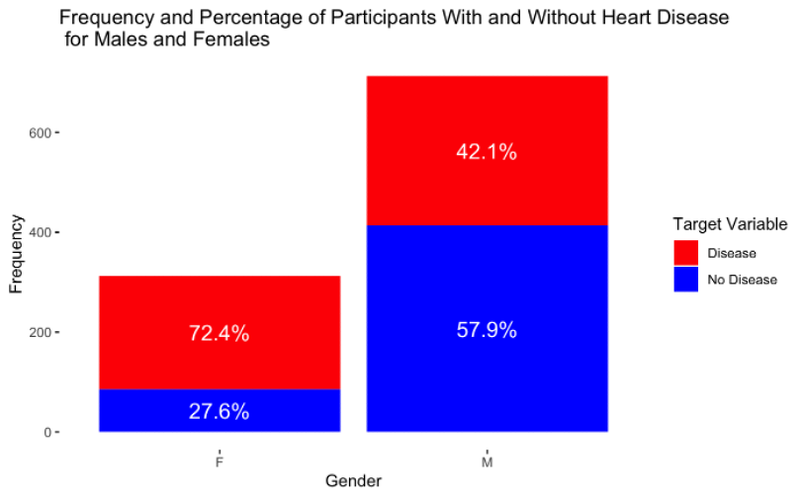
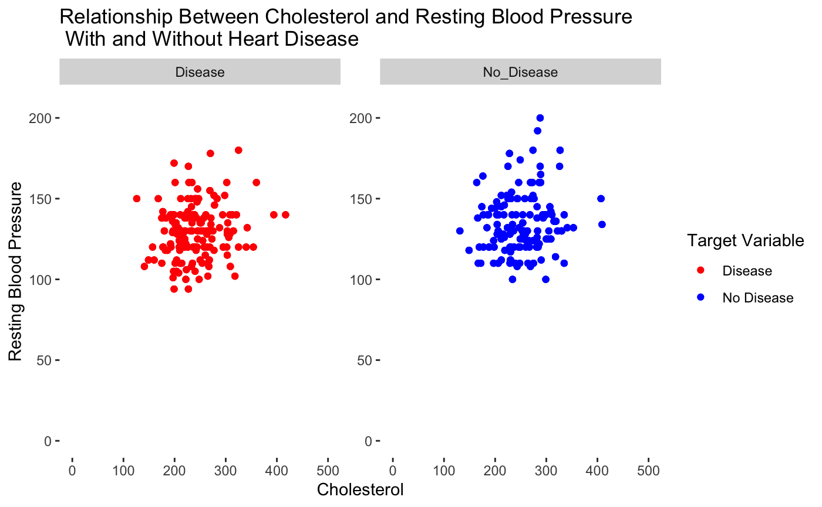
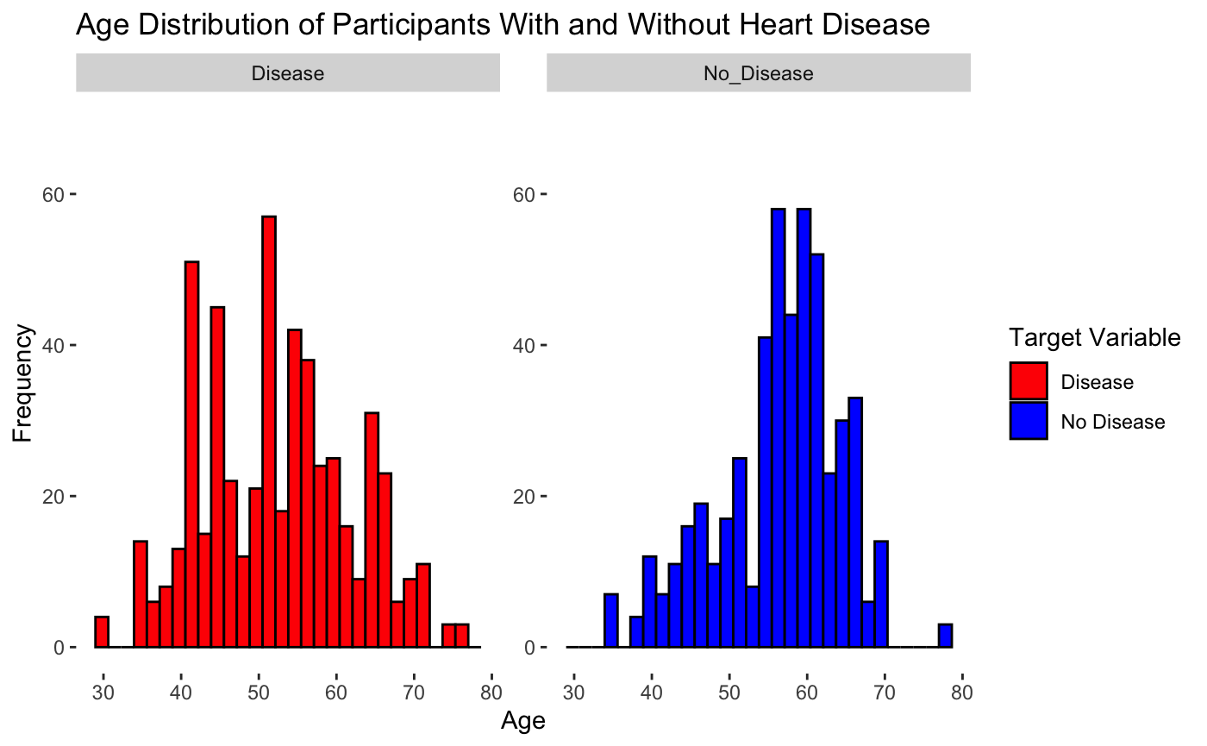
Exploratory Data Analysis
Almost 70% of participants in the study were male.
72% of female participants were diagnosed with heart disease, while 42% of male participants had the disease.
Frequency of participants in their 40s with heart disease was higher than those without the disease.

Slide 5
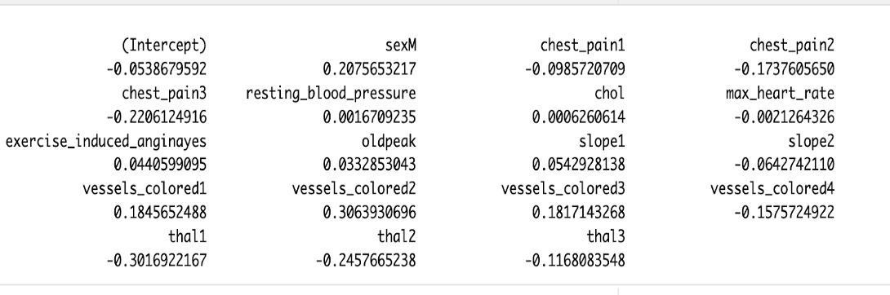
Logistic Regression Model
Key Findings:
Males: 20.76% more likely to have heart disease
Vessels colored 1, 2, 3: 18.46%, 30.64%, 18.17% more likely, respectively
Resting blood pressure: Each unit increase makes it 0.17% more likely
Chest pain type 1: 9.86% less likely to have heart disease
Chest pain types 2 and 3: 17.38% and 22.06% less likely, respectively
Vessels colored 4: 15.76% less likely

Slide 6
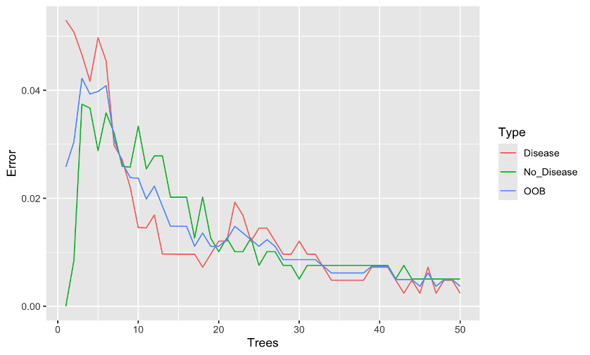
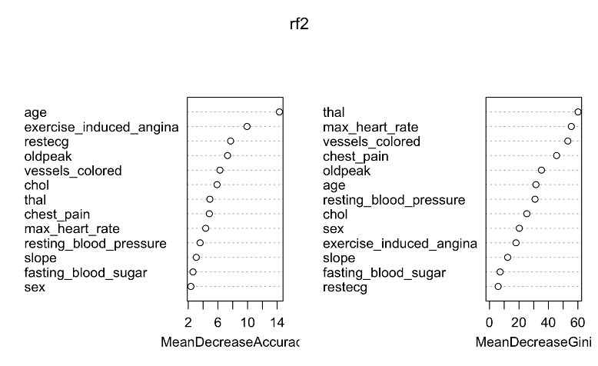
Random Forest Model
Initial Observations: Low out-of-bag (OOB) error rate, indicating potential overfitting.
Model Adjustments: Reduced the number of trees (optimal after 5 trees based on error rate plot)
Performed feature selection: Removed low-importance variables like fasting blood sugar, resting blood pressure, and slope.
Retained sex due to its importance in understanding gender-specific risks.

Slide 7
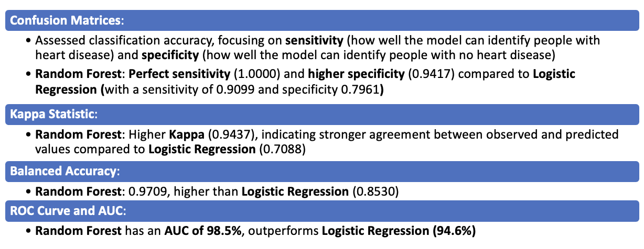
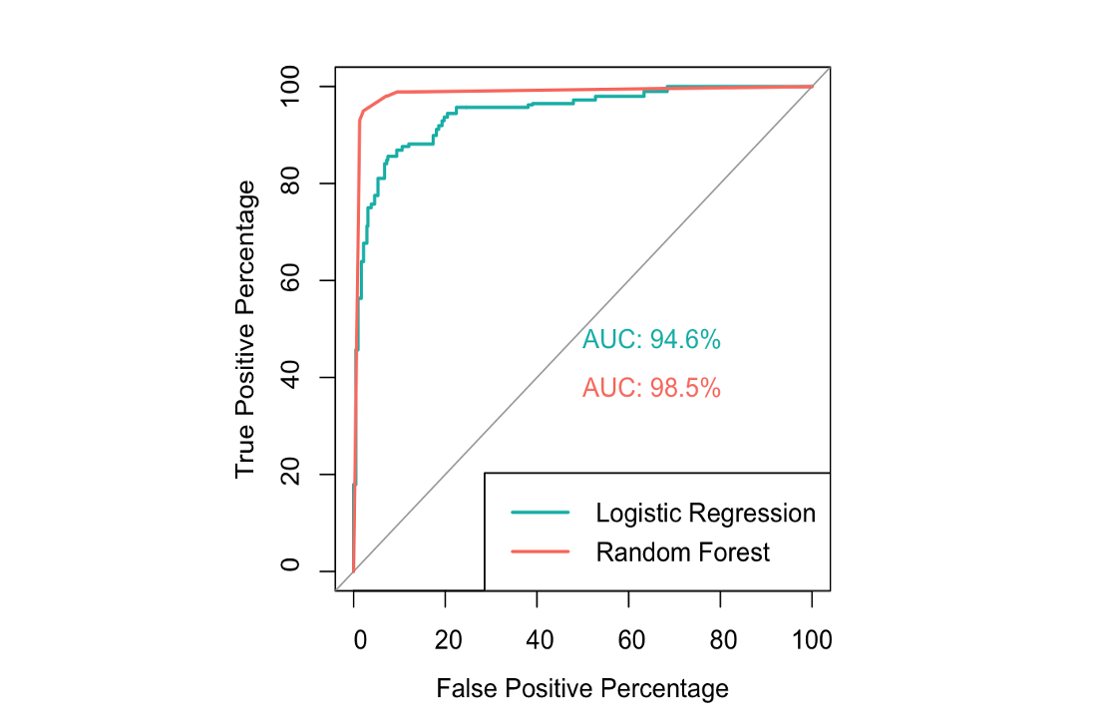
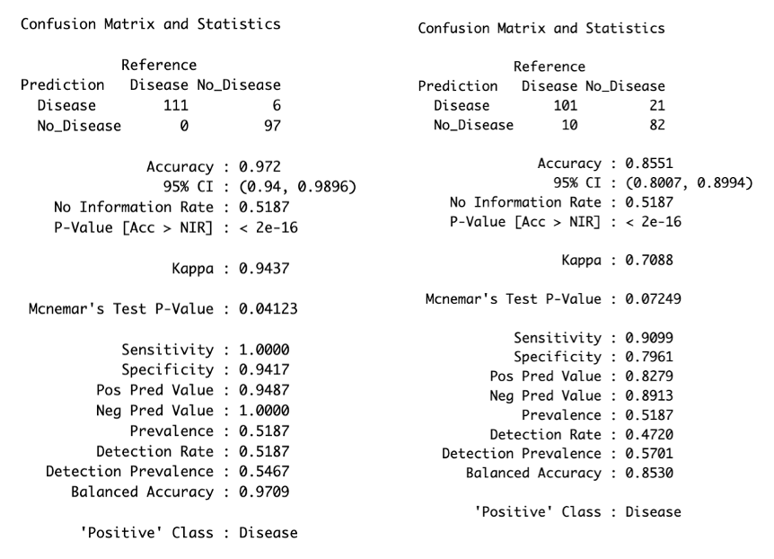
Model Comparison and Evaluation

Slide 8

Conclusion
While Random Forest demonstrated slightly better sensitivity and specificity, Logistic Regression was chosen as the preferred model due to its simplicity and ability to provide meaningful insights into key risk factors, making it well-suited for real-world applications where delivering key risk factors is essential.
The findings of this study align with Anshori, M., & Haris, M. S. (2022), where Logistic Regression was valued for its interpretability, computational efficiency, and practical use in clinical settings.
Future research should expand data sources that can improve prediction accuracy since the data set is very limited and small.

Slide 9
References
Yazdani A, Varathan KD, Chiam YK, Malik AW, Wan Ahmad WA. A novel approach for heart disease prediction using strength scores with significant predictors. BMC Med Inform Decis Mak. 2021 Jun 21;21(1):194. doi: 10.1186/s12911-021-01527-5. PMID: 34154576; PMCID: PMC8215833.
Anshori, M., & Haris, M. S. (2022). Predicting Heart Disease using Logistic Regression. Knowledge Engineering and Data Science (Online), 5(2), 188–196. https://doi.org/10.17977/um018v5i22022p188-196
Pal, M., & Parija, S. (2021). Prediction of Heart Diseases using Random Forest. Journal of Physics. Conference Series, 1817(1), 12009-. https://doi.org/10.1088/1742-6596/1817/1/012009
El-Sofany, H., Bouallegue, B. & El-Latif, Y.M.A. A proposed technique for predicting heart disease using machine learning algorithms and an explainable AI method. Sci Rep 14, 23277 (2024). https://doi.org/10.1038/s41598-024-74656-2

